Slide 1
Meaningful activity with sanctuary seekers
5th July 2016
Displaced people in Action/ City of Sanctuary

Slide 2
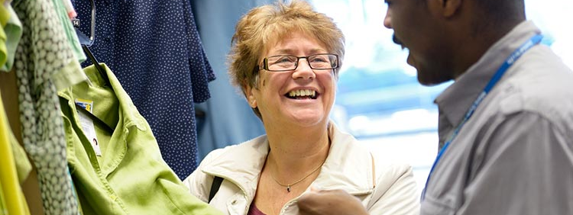
What is meaningful activity?
…or ‘occupation’: the ways in which we occupy our time day to day.

Slide 3
Occupations: the things we want or need to be doing in our everyday lives.
Productive roles
Work/ Volunteering
Parenting/ caring
Self care
Exercise/ keeping healthy
Shopping/ cooking
Leisure
Things we do for pleasure or therapeutic benefit
Socialising
Learning and education
Washing, getting dressed
Hobbies

Slide 4
Why is meaningful activity/ occupation important?
What occupations/ meaningful activities would you miss if you were told you were never able to do them again?
Why would you miss them?
What impacts do these occupations/ meaningful activities have on your life?
“Participation or involvement in everyday occupations is vital for all humans. As described by the World Health Organization, participation has a positive influence on health and well-being.” (Law 2002)

Slide 5
Impact of meaningful activity/ occupation
Health and wellbeing
Integration and identity
Everyday activities keep us healthy by:
Promoting physical activity/movement
Decreasing depression
Building self esteem
Giving motivation to engage in further activity
Promoting opportunity for socialising
Think about the people you know. How did you meet them? Was it through education, parenting, a shared interest?
Think about the first questions you ask when you meet someone new or identify yourself. ‘what do you do?’ ‘what do you enjoy doing?’

Slide 6
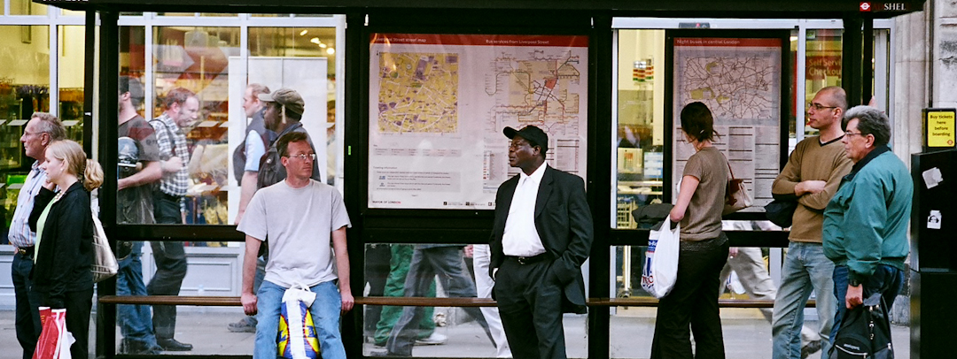
‘People come together through day-to-day activities, not integration projects’
(Department for communities and local government 2012, p8)

Slide 7
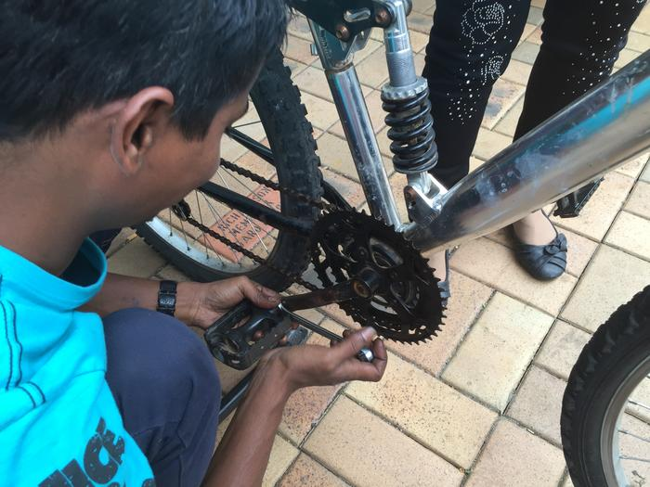
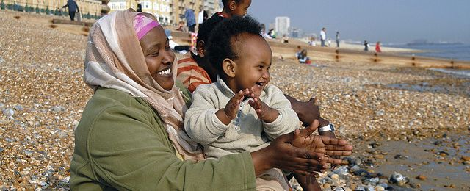
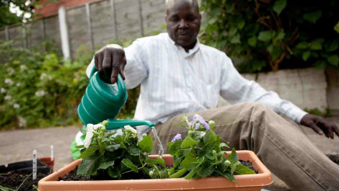
Why is this area so important with sanctuary seekers?
“Occupational deprivation is the result of individuals being denied the opportunity and resources to participate in occupations.”(Wolf et al)
This deprivation occurs as a result of:
Policy: not being allowed to work (or volunteer in some cases)
Poverty
Trauma/ mental health/ anxiety
Trying to engage in a new culture
Language
fear
The right to meaningful activity/ occupation is being promoted as a basic human right.

Slide 8
Giving it meaning
Every person will have their own idea of what activities/ occupations are meaningful for them.
Choice- many of us are lucky enough to be able to select the everyday activities we wish to engage in.
Can’t assume what works for one person will for another so we need to understand each individual and ensure there are a range of opportunities.
If these activities have meaning and purpose for the individuals then it will have maximum benefits in terms of health and integration.

Slide 9
Examples of meaningful activity opportunities for sanctuary seekers
productive
English language lessons
Classes and education
Self care
Food banks
Advice and support
Leisure
Free events- sports, family, leisure
Libraries
Volunteering opportunities
Drop-ins
Respite breaks

Slide 10
How we hope today will help
A clear picture of activities that already happen
Identifying gaps
Stronger partnership working
A clearer understanding of the importance of activities in all areas

