Slide 1

SCVS, a welcoming service supporting meaningful activity
Volunteering Services Team, Julia Manser

Slide 2

Visible, Audible & Knowledgeable
SCVS commitment to City of Sanctuary movement, displaying a “We Welcome” sign in front window since 2010
SCVS policies + advice & guidance best practice underlining the need for a reassuring , patient , welcoming approach
City of Sanctuary office within SCVS means we can easily draw upon CoS resources

Slide 3
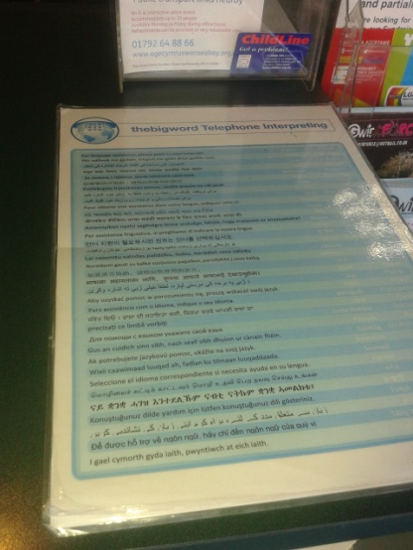
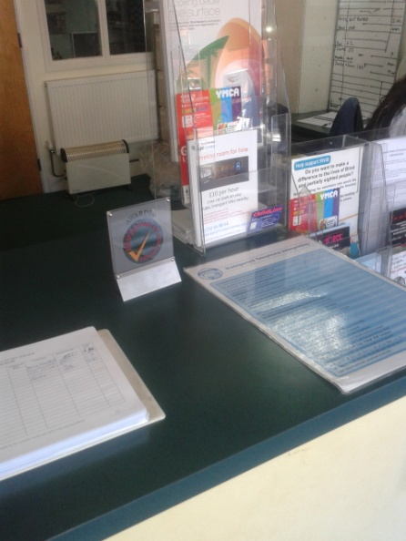
Spreading the Word / Supporting Communication
Making & developing connections with,
sharing information about volunteering with
& welcoming organisations staff / volunteers / others who support those seeking sanctuary
City of sanctuary volunteer mentors
Support workers
Friends & family
WITS translation support services

Slide 4
Supporting Volunteer involving organisations
SCVS Volunteering Services provides 1-2-1 development support to volunteer involving organisations regarding volunteer recruitment & management
Welsh Government Volunteering Policy “Supporting Communities, Changing Lives” August 2015

Slide 5

Facilitated by SCVS Volunteering services team
a members network of volunteer managers which meets every 2 months to develop and share best practice.
Feb 2016: City of Sanctuary volunteer & staff members present to the Swansea Volunteering Forum to aid volunteer involving organisations improve their practice in recruitment & support of volunteers who are seeking sanctuary.

Slide 6

Code of Practice for Organisations involving volunteers
Best practice guidance for organisations, updated in 2016 by Wales Volunteering Policy Network
20 statements reflecting the principles of Investing in Volunteers award.

Slide 7

Key to recruiting & supporting volunteers including those seeking sanctuary POINT 5

Slide 8

Key to recruiting & supporting volunteers including those seeking sanctuary POINT 7

Slide 9
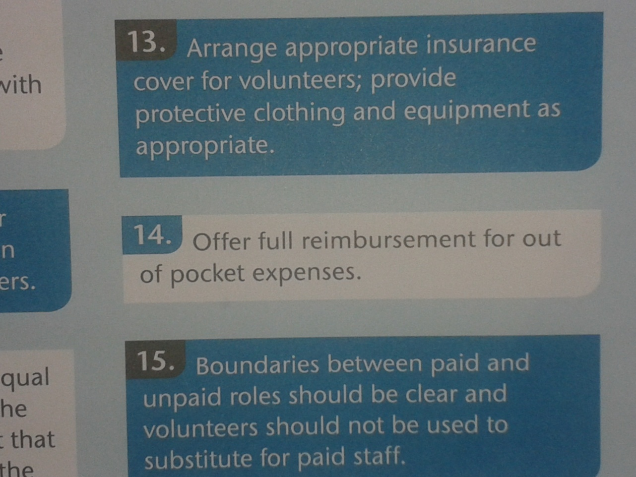
Key to recruiting & supporting volunteers including those seeking sanctuary POINT 14

Slide 10


