Slide 1

Chair’s Annual Report 2023
Alan Thomas

Slide 2
Context: 2023
UK government “hostile environment” even worse – “Stop the Boats”:
- Illegal Migration Act;
- Safety of Rwanda (Asylum and Immigration) Bill
Rise in hate speech (Stradey Park hotel fiasco in Llanelli; buses incidents)
Continuing backlog of asylum cases BUT
- more people dispersed from hotels;
- more getting Leave to Remain (pressure on local housing)
Welsh Govt policy (“Integration begins from Day One”):
- “Nation of Sanctuary” strategy being reviewed
UK CoS: new Wales Co-ordinator; Sanctuary in Politics in Swansea;
emphasis on “streams” and on campaigning; Stand Up for Sanctuary course

Slide 3
Management Committee 2023
Alan Thomas (Co-Chair)+ | Krys Williams
Carlos Ibarra Rivadeneira (Co-Chair)+ | Leigh Hooker+
Stephen Richardson (Co-opted; Treasurer from April) | Martha Ako
Betul Karagoz* | Stephanie Jones+
Carys Davies
Funmilayo Olaniyan | [Observer: Jim Downey*]
Grace Rungua+ | [Observer: Kelly Wearing]
Jose Cifuentes* | [In attendance: Hazel Nixon]
*Left during the year
+ Standing down at 2023 AGM

Slide 4
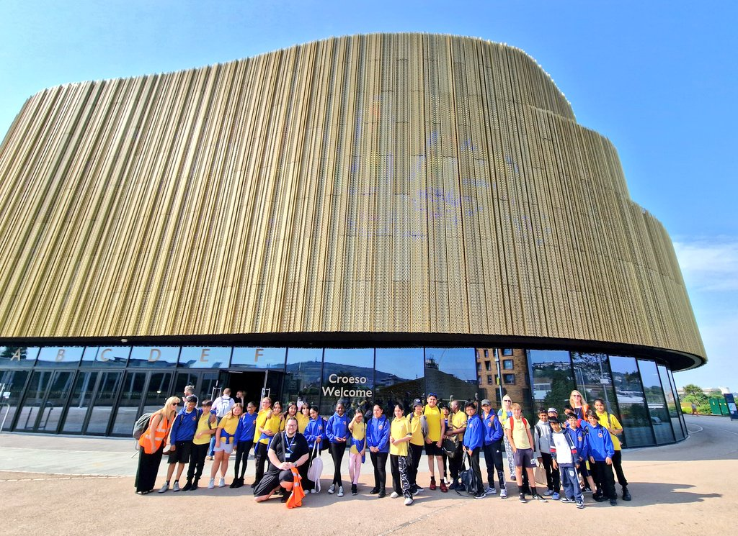
Swansea School of Sanctuary Awards
Celebration held at Swansea Arena!
Awards made to:
St Helen’s Primary
Christchurch Primary
St Joseph’s Cathedral Primary (reaccreditation)
Bishop Vaughan

Slide 5
Sanctuary in Politics course
UK City of Sanctuary course (7 iteration run in Swansea Nov ’23)
Aimed at asylum seekers, refugees and other migrants
2-day residential plus online intro and follow-up
Modules on:
- the UK (and Welsh) political system
- campaigning and making one’s voice heard
- working with the media
16 participants (over half from Swansea); 10 mentors
Participants complete course with individual projects/ assignments

Slide 6
Other Highlights
Major Swansea Institutions working towards national awards:
- UWTSD and Swansea University
- Swansea Central Library/ Library Service/ Prison Library
- City and County of Swansea
Asylum Seeker and Refugee Coordination (AS&RC) meetings
Consultation on Future Priorities
Awareness-raising and fundraising events: World Social Work Day; Tabletop sale with SASS; Waterfront “GRAFFT” supper; Mumbles Churches Together; “These Thrilling Lies” gig; etc.

Slide 7



Partnership Projects
A Better Welcome to Swansea
(with SCVS)
Share Tawe
(now independent; run by EYST)
HarMINDise
(Young Persons Resilience Project; run by ACC)

Slide 8
Priorities following “Not an Away Day”
Facilitating cooperation between support organizations
- Better information for asylum seekers
Empowering refugee voices
- Support ‘Sanctuary in Politics’ graduates
- Run ‘Speak Up for Sanctuary’ locally
Local activities (Travelling Exhibition etc)
Workshops/Networking:
- Sanctuary and Wellbeing for Young People (for HarMINDise)
- Interfaith Conference
Awards:
- Schools of Sanctuary;
- Other Sanctuary Awards

Slide 9
Challenges
Largely new committee
Need to mobilise and motivate volunteers effectively
Prioritise making refugee voices heard
Push through new constitution
Continue regular consultation with members and supporters
Need to fund paid admin/ comms support (via both local fundraising and grants)
Move from Consultation to ACTION!

Slide 10
Overall… more than ever…
We can and must continue to counter the false narrative that the public is hostile.
We can demonstrate that support for welcome and inclusion remains strong both in public institutions and the public as a whole.

Slide 11
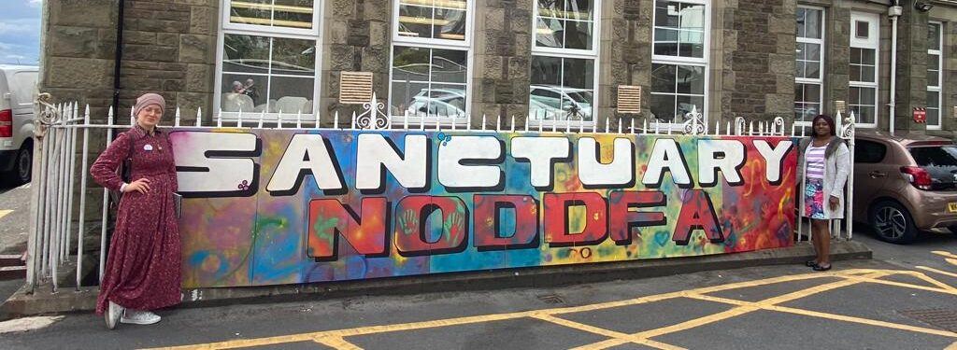
Any questions?

