Slide 1


Slide 2
Co-Chair Report 2022

Slide 3
Context: 2022
First post-Pandemic year: face-to-face and Zoom
Ukrainian conflict and refugees
UK government “Hostile Environment” worse and worse: Nationality & Borders Bill, Rwanda deportation policy, huge backlog of asylum cases
Welsh Govt policy: “Nation of Sanctuary” (“Integration begins from Day One”); “All In”
UK CoS: network growing; more “streams”; new Wales Co-ordinator

Slide 4
Management Committee 2022
Alan Thomas (Co-Chair) | Carys Davies
Carlos Ibarra Rivadeneira (Co-Chair) | Grace Rungua
Kathryn Williams (Secretary) | Klaudia Krogulec
Helen Gough (Treasurer) | Domini Lewis*
Krys Williams | Sibu Mbwembwe*
Funmilayo Olaniyan | Richenda Leonard*
Jose Cifuentes
 | * resigned during year

Slide 5
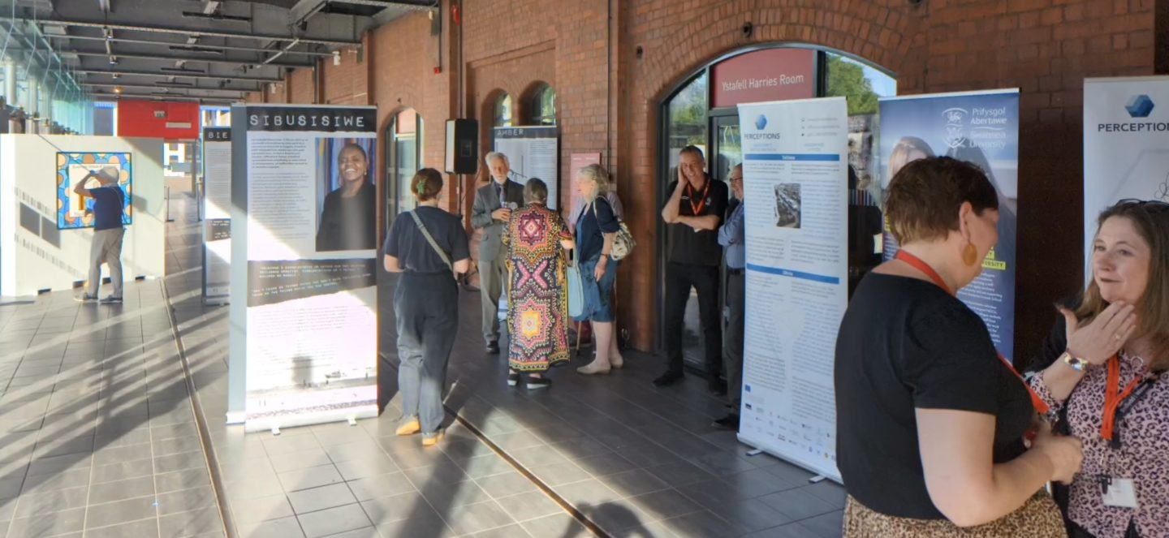
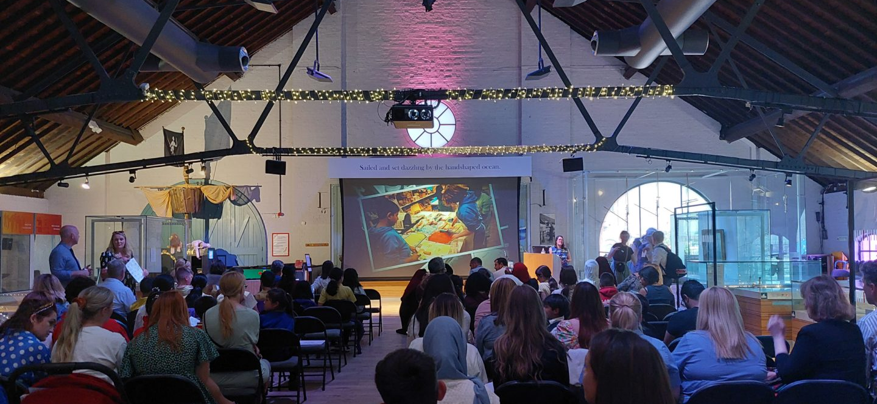
Highlights
Home Away From Home Exhibition
Five new Schools of Sanctuary
Refugee Employment Workshop and potential new Group
‘CAMP’ Group and Refugee Stories
Rallies against Rwanda deportation policy
Social events: Inderjit Bhogal visit to Sketty; Twmpath

Slide 6
Swansea Sanctuary Awards 2022
Schools of Sanctuary
  Brynmill Primary
  Hafod Primary
  Terrace Road Primary
  Waun Wen Primary
  Pentrehafod Secondary (renewal - 1st School of Sanctuary in Wales 2013)
Other Sanctuary Awards
  Humanities Department at Ysgol Gyfun Gŵyr
  St James’ Church, Uplands - 2nd Church of Sanctuary in Swansea
  Down to Earth (renewal – previous award 2017)
  Waterfront Museum (renewal - 1st Museum of Sanctuary in UK 2018)

Slide 7



Partnership Projects
A Better Welcome to Swansea
(with SCVS)
Share Tawe
(now independent; run by EYST)
HarMINDise
(New Young Persons Resilience Project; run by ACC)

Slide 8
Renewal: Achievements and Challenges
Largely new committee
Growing volunteer capacity – need to mobilise effectively
New structure including regular consultation with members and supporters and new sub-groups – not yet fully implemented
Continuing paid admin/ comms support
Focus on (limited) fund-raising:
  Joint events (e.g. Twmpath with SASS)
  External grants e.g. £6000 from Allen Lane Foundation
  Focus on limited set of priority activities during renewal period

Slide 9
Priorities for next two years?
Travelling Exhibition
Empowering refugee voices
Schools of Sanctuary
Other subgroups (including Parks and gardens; Sanctuary Arts Network; Refugee employment)
Facilitating cooperation between support organizations – e.g.:
  Regular clinic with different asylum support services
  Up-to-date information on services for sanctuary seekers
  Joint action on transport for asylum seekers
TO BE CONFIRMED (possibly reduced)

Slide 10
Overall, we can and must continue to counter the false narrative that the public is hostile.
We can demonstrate that support for welcome and inclusion remains strong both in public institutions and the public as a whole.

Slide 11

We are proud to be a place of safety!
Refugees are part of us!

